Slide 1
Data Analysis and Visualization for Sunshine Deserts Using SQL and Tableau

Slide 2
Retrospective Analysis: Sunshine Deserts (1985-2001)
OBJECTIVE: Review company performance from 1985 to 2001.
AREAS OF FOCUS:
Overall Performance Trends: Revenue, profits, and growth.
Sales Analysis: Yearly sales, key product performance, and regional breakdown.
Market Position: Market share, competitor comparison, and industry trends.
Operational Efficiency: Cost analysis, production efficiency, and resource utilization.
Customer Insights: Customer acquisition, retention rates, and satisfaction metrics.
Financial Health: Cash flow, debt levels, and investment returns.
OUTCOME: Present findings to the board with commentary and insights .

Slide 3
Retrospective Analysis: Sunshine Deserts (1985-2001)
Task 1. Submit some top-level figures regarding the business as mentioned below
Top-Level Business Figures: 1985 vs. 2001
Company-Wide Overview:
Total Employees: Comparison between 1985 and 2001.
Total Salary Spend: Growth in salary expenditure over the years.
Gender Balance: Male vs. female ratio across the company in both years.
Departmental Breakdown:
Employee Count: Per department for 1985 and 2001.
Salary Distribution: Department-wise salary spend comparison.
Gender Distribution: Gender ratio within each department for both years.

Slide 4
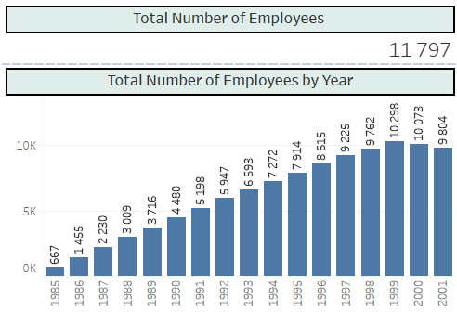
Employee Growth Dynamics: (1985-2001)
Total Employees (2001):11,797
Trends:
1985-1999: Consistent upward growth in employee numbers.
1999 Peak: Highest employee count reached.
2000-2001: Sharp decline in employee numbers.
Key Insights: Clear visualization of growth followed by decline.

Slide 5
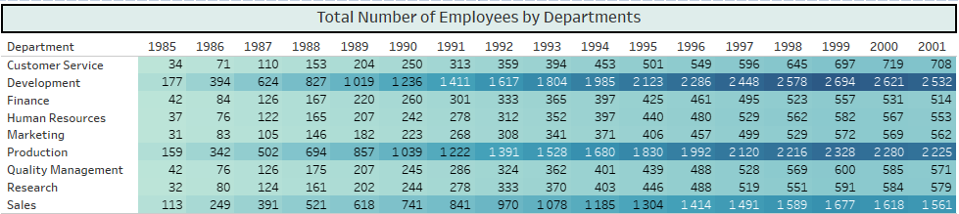
Employee Distribution by Department: 1985-2001
Overall Trend: Increase in employee numbers across all departments.
Notable Growth:
Development: Significant rise in staffing.
Sales: Major increase in employees.
Production: Largest growth observed.

Slide 6
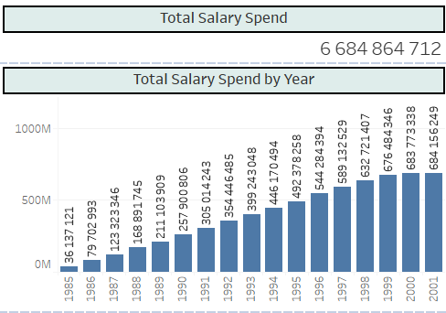
Employee Payroll Dynamics: 1985-2001
Trend Overview: Steady increase in total wages from 1985 to 2001.
1985-1999: Consistent upward trend in payroll.
2000-2001: Continued growth, but at a slower pace.
Key Insight: Payroll growth reflects changes over time, influenced by economic factors.
.

Slide 7
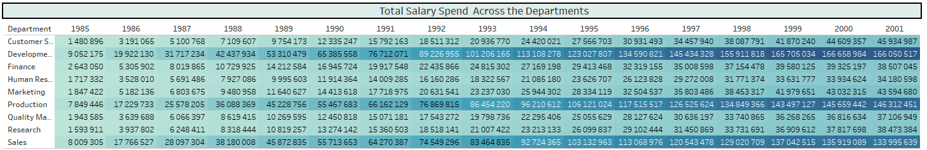
Departmental Salary Growth: 1985-2001
Overall Increase: All departments show growth in payroll.
Significant Growth: Notable in Development, Sales, and Production due to employee increases.
Data Considerations:
Salary data recorded annually.
Wages attributed to the department where employees were at the start of each payroll period.

Slide 8
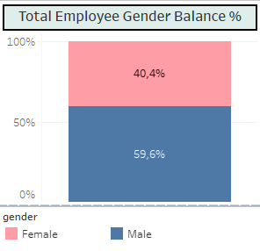
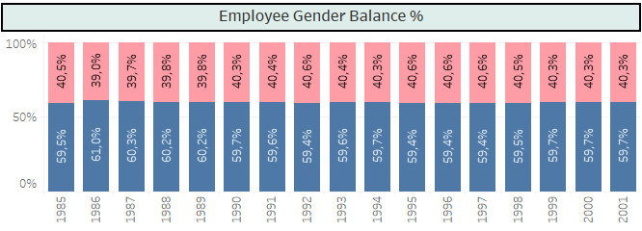
Gender Balance: 1985-2001
Overall Ratio: ~60% male, 40% female.
Yearly Trend: Consistent gender balance throughout the years.
Key Insight: Stable gender distribution across the entire period.

Slide 9
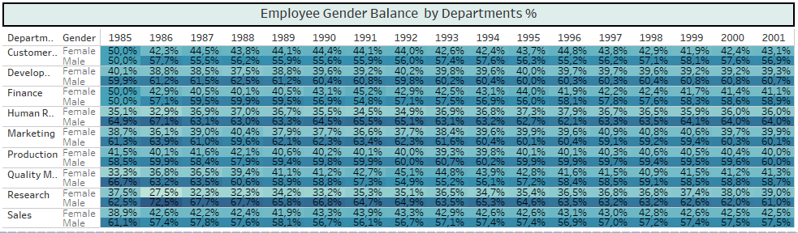
Departmental Gender Balance: 1985-2001
Human Resources & Research: Consistent disparity, ~65% male, 35% female.
Quality Management: Early imbalance, later aligned with company average.
Overall: Most departments achieved balanced gender ratios by 2001, except Human Resources and Research.

Slide 10
Retrospective Analysis: Sunshine Deserts (1985-2001)
Task 2: Salary Spend Comparison Analysis
How has the salary profile changed within each department from 1985 to 2001?
What metric would you recommend for comparing salary spend within each department, and why?
Given the time gap between 1985 and 2001, what factors should be considered when comparing salary figures? Should adjustments be made, and if so, how?
Are there additional analyses you would recommend to inform the CEO about changes in salary spend?
What data limitations might affect this analysis, and how can these limitations be addressed?

Slide 11
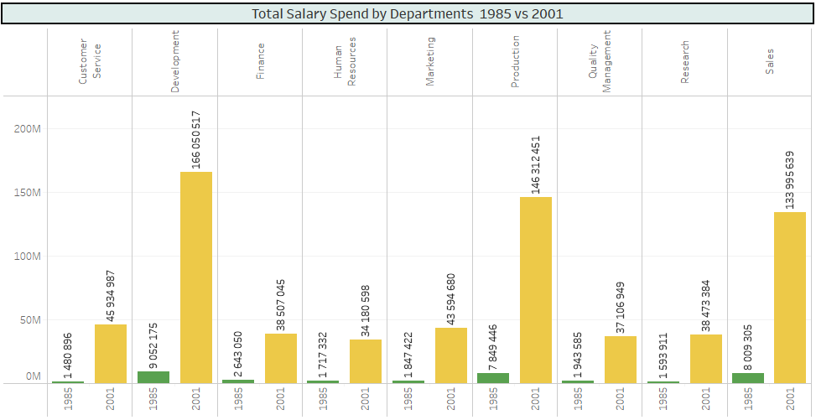
Total Salary Spend: 1985 vs. 2001:
Data Limitation: As salary is recorded annually; difficult to track inter-departmental salary changes
.
Analysis Basis: Wages attributed to the department where employees were at the start of each payroll period.
Chart Highlights:
Total salary fund grew in 2001 across all departments. As cab be seen by the rise in number of employees and higher salaries.

Slide 12
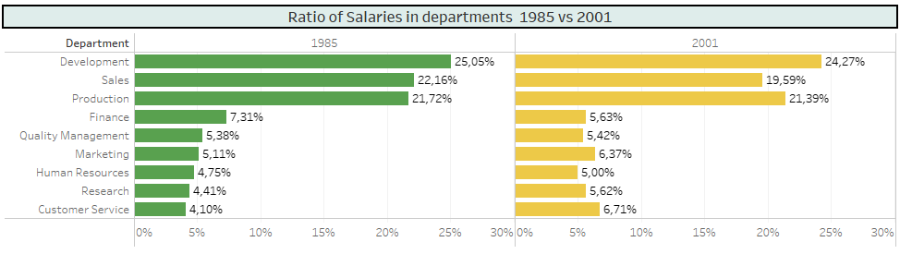
Departmental Salary Share: 1985 vs. 2001:
Largest Payrolls: Development, Production, and Sales departments had the highest payrolls in both 1985 and 2001.
Cost Structure Changes:
Decreased Share: Payroll costs in Sales and Finance departments reduced relative to total costs.
Increased Spending: Higher payroll costs in Marketing, Research, and Customer Service departments.

Slide 13
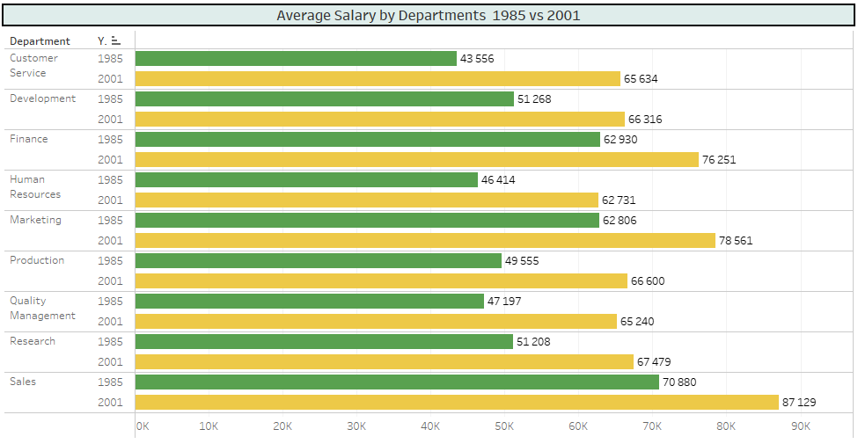
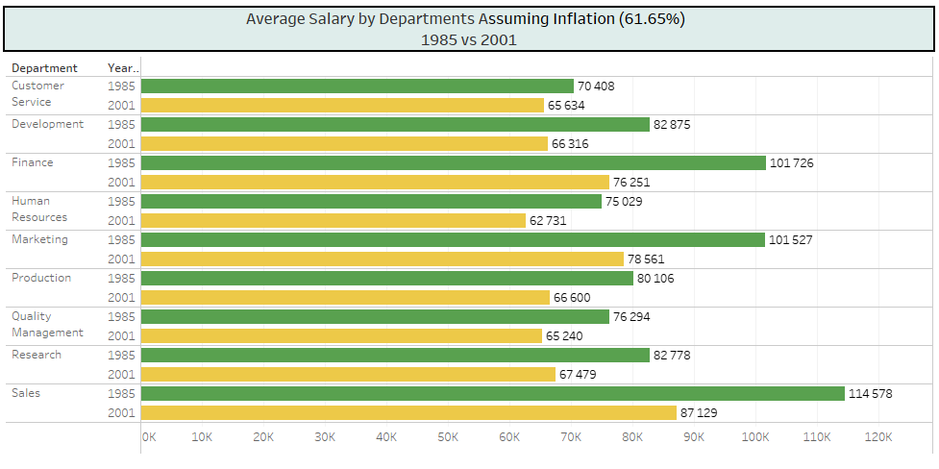
Comparing Departmental Salaries: 1985 vs. 2001
Average Salary Comparison:
Nominal Salaries: Higher in 2001 across all departments compared to 1985, indicating increased nominal salary levels.
Indexed Salary Analysis: Indexation Adjustment: Adjusted 1985 salaries to 2001 US dollar value (61.65% of 1985 level).
Real Salaries: Indexed salaries show a decrease in real salary levels from 1985 to 2001, reflecting reduced purchasing power.

Slide 14
Retrospective Analysis: Sunshine Deserts (1985-2001)
Task 3: Gender Balance and Salary Analysis
Gender Profile:
What is the gender distribution across departments in 1985 vs. 2001?
How can these gender profiles be explained?
Salary Analysis:
Is there evidence of salary bias between genders in 1985 and 2001?
Departmental Gender Bias:
Are some departments more gender-biased than others?
Has the gender balance within departments changed over time?
Trends and Balance:
Which departments are more balanced or biased?
What factors might contribute to these departmental differences?

Slide 15
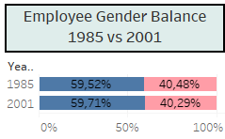
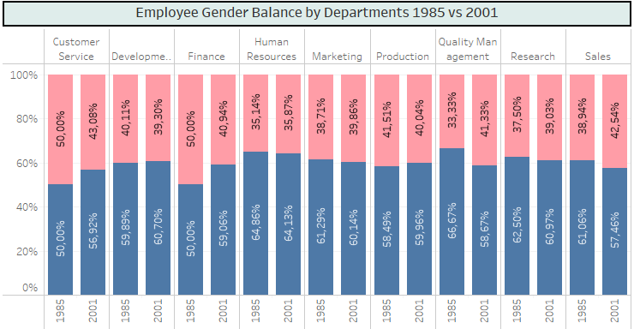
Gender Composition by Department: 1985 vs. 2001:
Human Resources:
Gender Disparity: ~65% male, 35% female.
Quality Management & Research:
Early Inequality: Improved to align with overall company average by 2001.
General Trend:
Gender Balance: Most departments aligned with the company’s overall gender ratio of 60% male and 40% female.
Exception: Human Resources department remains an outlier.

Slide 16
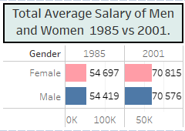
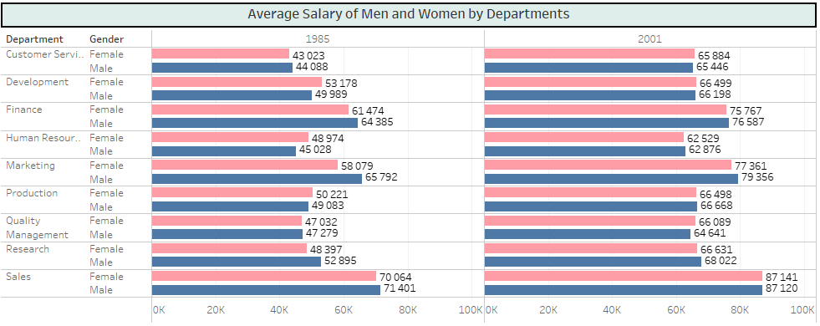
Gender Wage Analysis: 1985 vs. 2001:
Overall Wages: Average wages for men and women were similar in 1985 and 2001.
Departmental Trends:
Marketing & Finance:
1985: Men’s average wages higher than women’s.
2001: Wage gap persists, though reduced.
Development & Human Resources:
1985: Women earned higher average wages.
2001: Wages equalized between genders.

Slide 17
Retrospective Analysis: Sunshine Deserts (1985-2001)
Task 4. Calculate the churn of employees in 2001:
How does employee churn vary across different departments?
What conclusions can be drawn from the churn patterns observed?
In 2001, which departments are more susceptible to higher employee churn?
What factors might contribute to higher churn rates in these departments?

Slide 18
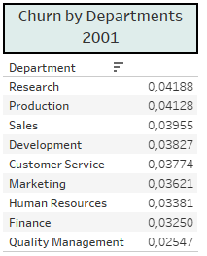
Employee Churn Analysis( 2021): Highest Turnover: Research: 0.0419 Production: 0.0413 Observation: Greatest personnel changes. Low Turnover: Quality Management, Finance, Human Resources: Low staff turnover, indicating stability. Sales, Development, Customer Service, Marketing: Slightly higher turnover than the above departments, but still low. Conclusion: High Turnover Departments: Research and Production, suggesting potential issues needing attention. Stable Departments: Quality Management, Finance, Human Resources, and Marketing.

Slide 19


